Slide 1
Covid 19 Analysis
File created on: 4/24/2025 9:54:40 AM

Slide 2
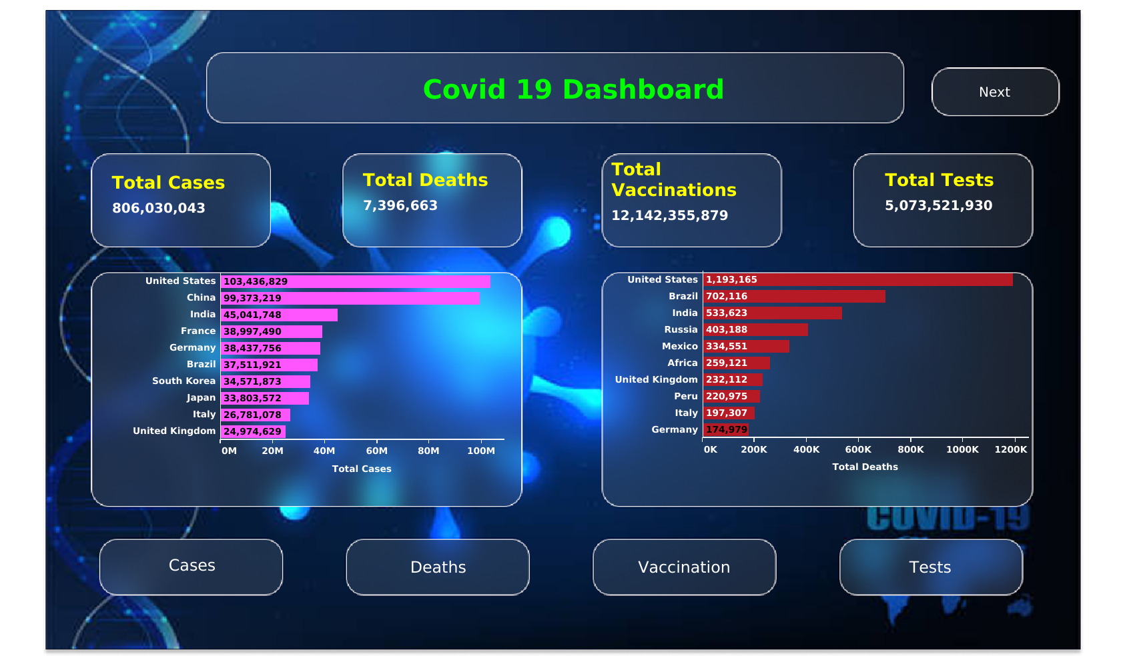

Slide 3
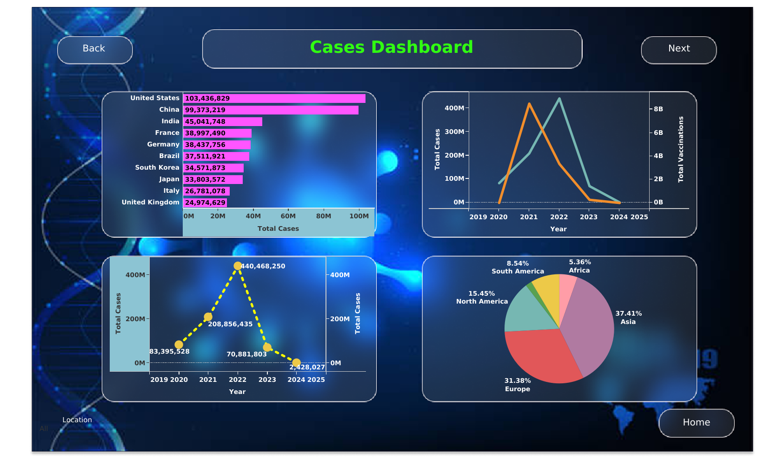

Slide 4
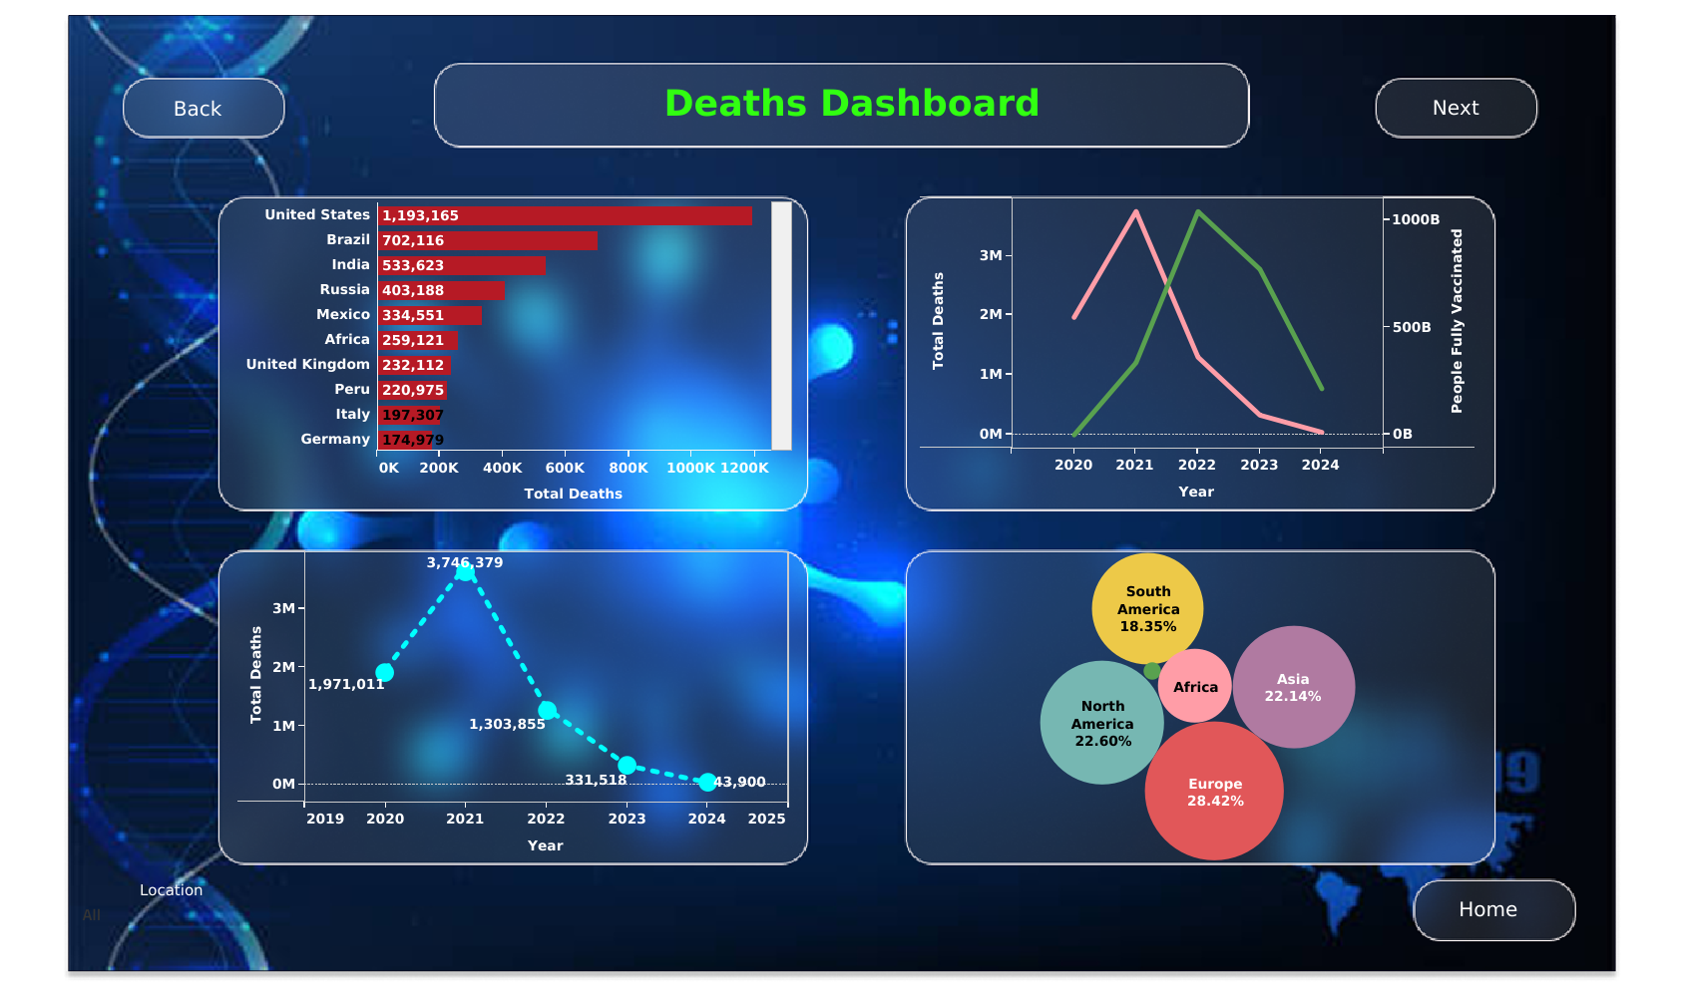

Slide 5
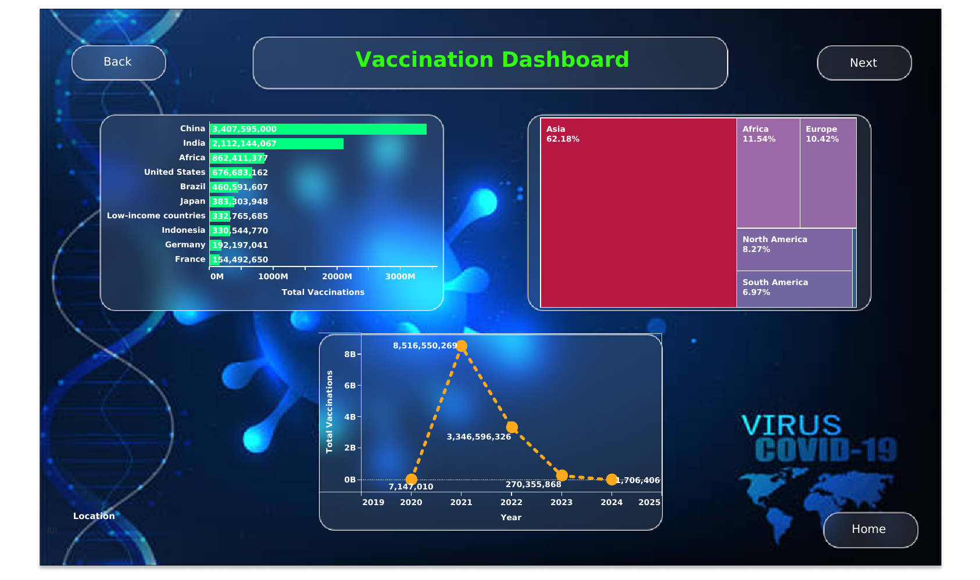

Slide 6
